Slide 1
Nfi and accessible chromatin
NfiX has low occurrence in accessible chromatin (i.e. DHS sites)
Far lower than Math1 (something we were looking at as interacting with Nfix)
Sites bound by NfiX at P7 appear to open in P14 and P60
 | P7 | P14 | P60 | Peaks
NfiA | 2941 | 3409 | 3790 | 18447
NfiB | 7342 | 8657 | 9657 | 44606
NfiX | 1180 | 1389 | 1531 | 8036
Math1 | 8250 | 7575 | 6749 | 8480

Slide 2
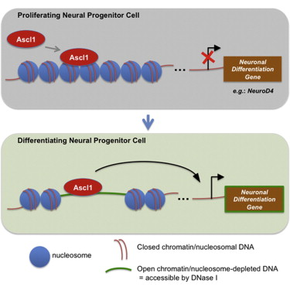
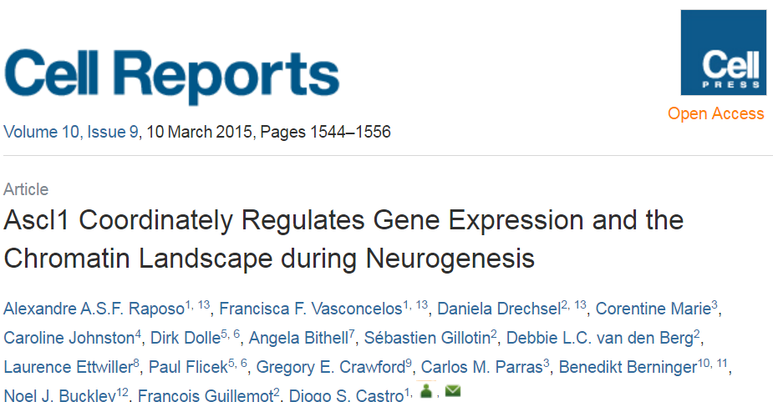
Ascl1 as pioneer factor (example)
“Ascl1 binding correlates with activation of gene transcription, targeting not only regions of accessible but also of closed chromatin.”
“binding of Ascl1 to DNA precedes a local increase in chromatin accessibility at the regulatory regions of its target genes, providing the first direct link between Ascl1 regulation of gene expression and local changes in chromatin landscape”

Slide 3
Sites opening from P7→P14
Given Nfix binding sites at P7, do any become accessible at P14 given the DHS data?
39 genes are targeted by NfiX binding sites that occur at regions which are open in P14 but not P7
Many seem relevant to differentiation, development and neural function
(Analysis would have to be rerun to apply updated techniques and improve confidence in outcome)
Plekhd1 Rgs3 Plxna4 Iqsec1 Cacna1c | Scn1b Rgma B3gat1 Cacna1e Grm4 | Ptprm Col5a1 Fbxo2 Cpz Lfng | Slc41a3 Itsn1 Ptprz1 Loxl1 Mmp17 | Rxra Pdgfc Kmt2a Sgsm1 Aqp1 | Ror2 Mboat1 Ier5 Itgb5 Ksr2 | Tspan11 Unc13a Sik1 Wwc1 Tmem132b | Vwf Ptpn3 Rbfox3 Arid1a

Slide 4
Pioneer factors
Transcription factors that can directly bind inaccessible chromatin
Can actively open local chromatin
Make it accessible to other factors
Other criteria
Bind to genome for period prior to activation (accessibility/transcription)
Bind to genome prior to other factors binding
Could NFIX be a pioneer factor?
Majority of NFIX binding events are to inaccessible DNA
Temporal accessibility data showed evidence of NFIX binding sites becoming accessible

Slide 5
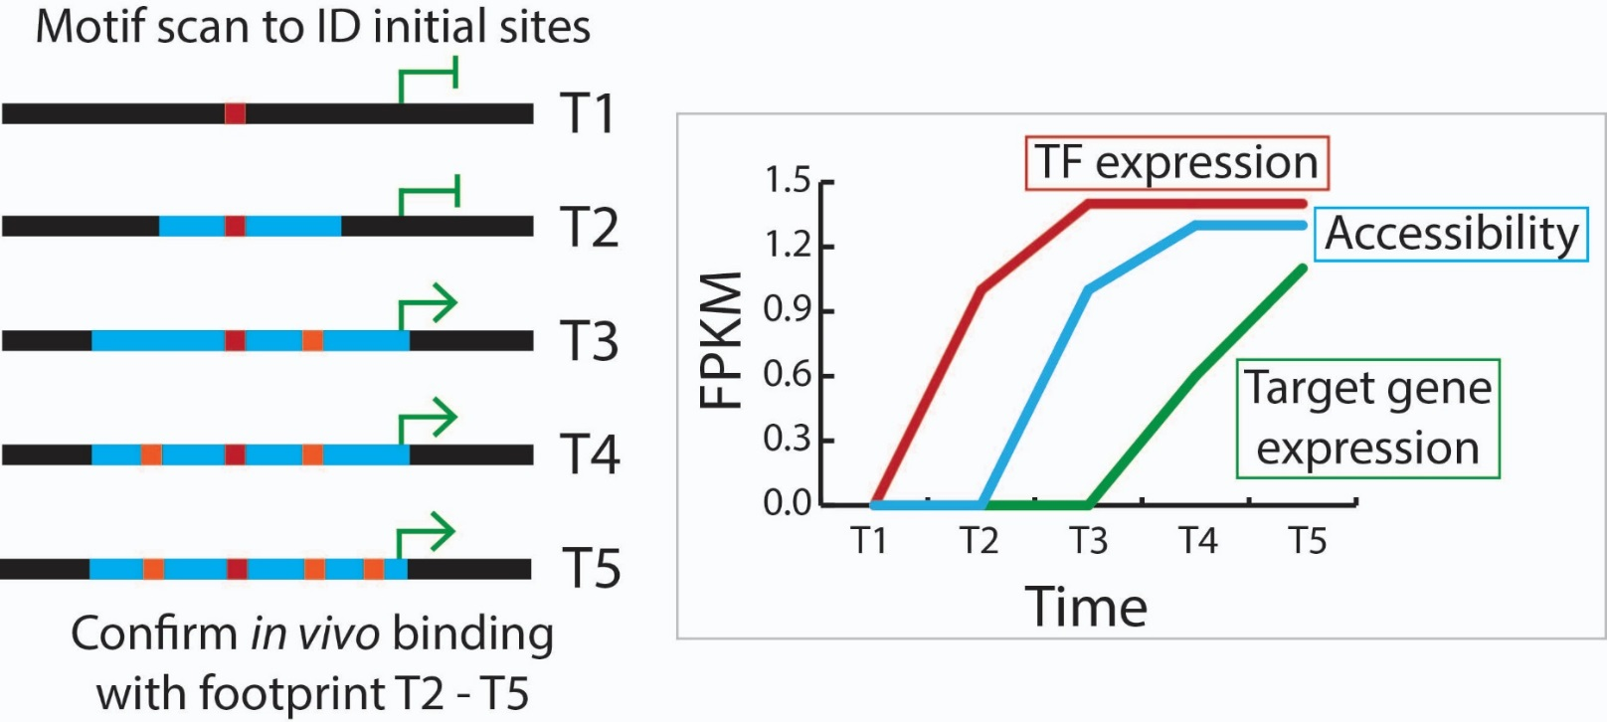
NFIX binds inaccessible DNA
Individual examples of pioneer factors exist but could you do a global scan?
Data requirements
Temporal
Accessibility AND RNA
Known sequence motifs
Filtering criteria left next to no data
Few transcription factors showed expression changes over time points
Even fewer had known motifs (essential to ID binding locations)
Notes:
Also tried to look at ENCODE data to see how often TFs bound inaccessible DNA and didn’t observe any patterns

Slide 6
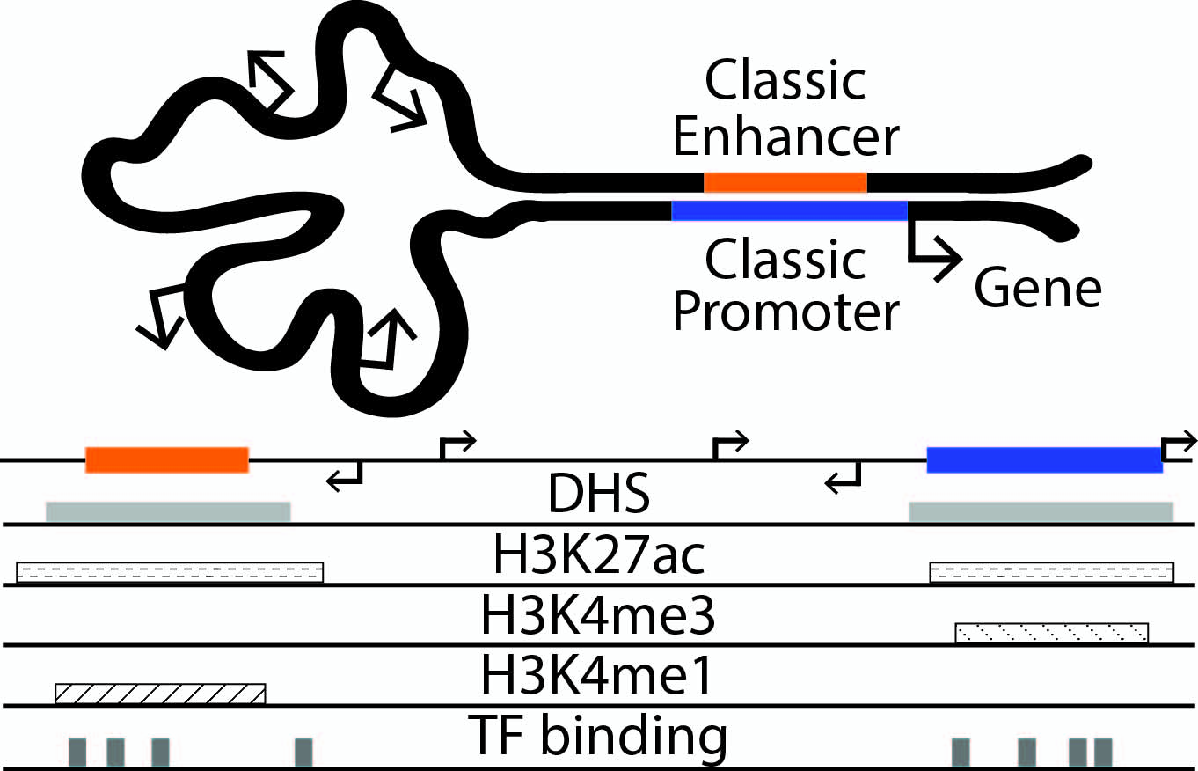
Graph theory inspired framework to explore patterns and relationships of interaction networks
DNA loops, distal interactions, chromosome conformation capture
ChIA-PET, 3C, 4C, 5C, Hi-C, CHi-C
No data structure able to store paired output data
Pairs often treated independently
Consider higher order structure
Interpret interactions as graphs/networks

Slide 7
Why graph theory?
Paired data forms a higher order structure: a complex graph
Nodes exist with higher than average number of edges
Provides more information than individual pairs
Allows exploration of different types of patterns

Slide 8
Challenges
Aim: Identify biologically relevant target genes and/or interactions
Example patterns evaluated
Node degree and expression
Graph complexity and cell type specificity
Epigenetic patterns shared between linked nodes
Epigenetic patterns on graph edges
Challenging to validate
Trouble finding true interactions
Trouble confirming biological significance of target gene sets

