Slide 1
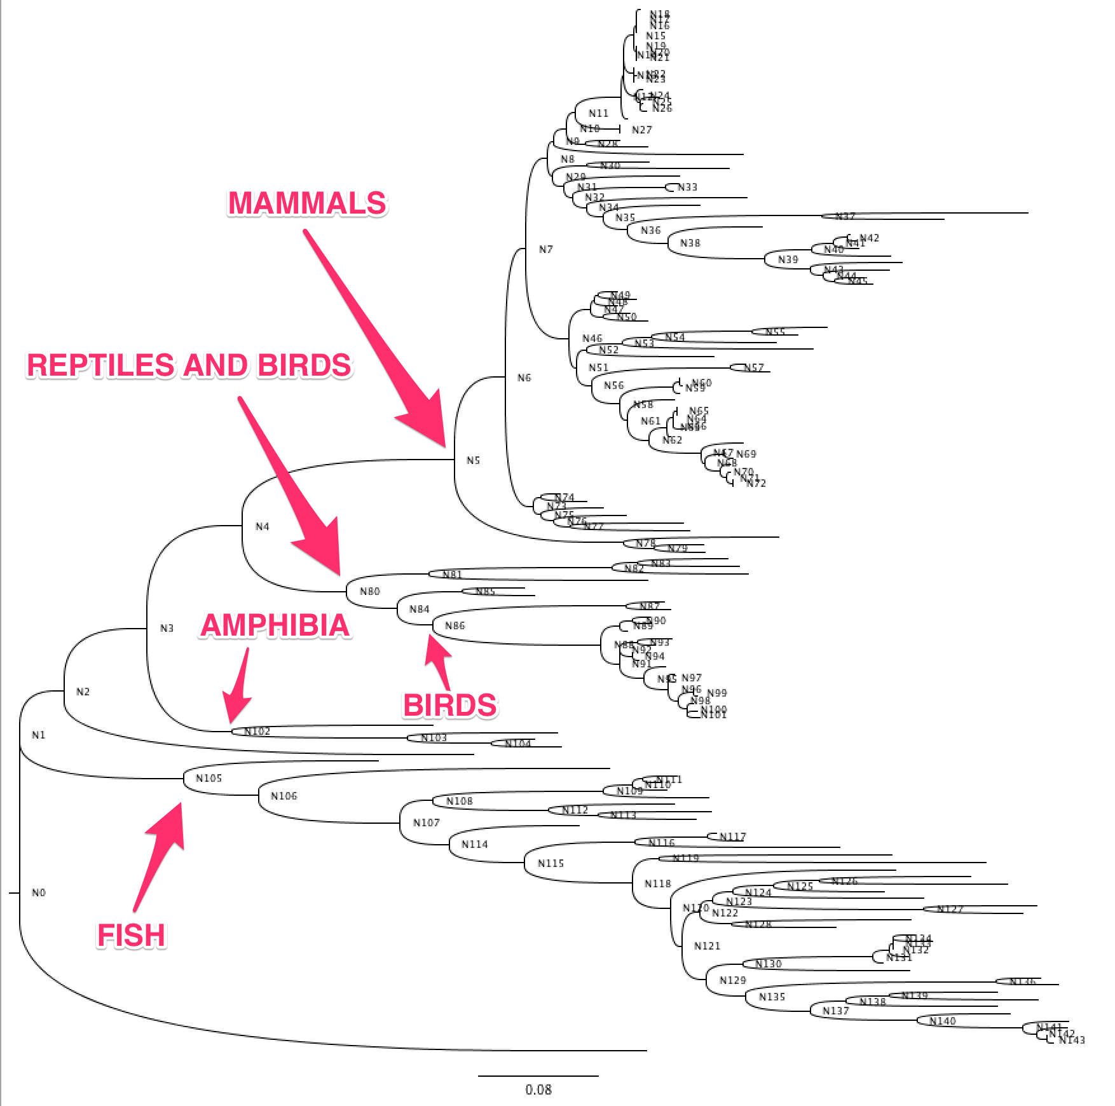
Cytochrome P450 2U1 family
145 Sequences
H1: Evolutionary age increases thermostability
H2: Reduction of the number of amino acids increases thermostability
Variable region 1
Variable region 2

Slide 2
Cytochrome P450 2U1 family
Ancestor 1: Joint reconstruction of root node. (483 amino acids) Ancestor 2: Joint reconstruction of root node with variable region one removed. (461 amino acids) Ancestor 3: Joint reconstruction of the fish ancestor with insert / insert. (487 amino acids) Ancestor 4: Joint reconstruction of the fish ancestor with insert / delete. (483 amino acids) Ancestor 5: Joint reconstruction of the fish ancestor with delete / insert. (475 amino acids) Ancestor 6: Joint reconstruction of the fish ancestor with delete / delete. (471 amino acids) Ancestor 7: Joint reconstruction of root node with alternative pathway through variable region one. (485 amino acids)
Ancestor 8: Joint reconstruction of the ancestor of the mammals branch and reptiles / fish branch. (485 amino acids) Ancestor 9: Joint reconstruction of the FastML ancestor with variable rates and gaps inferred using maximum likelihood (485 amino acids)
Variable region 1
Variable region 2

