Slide 1
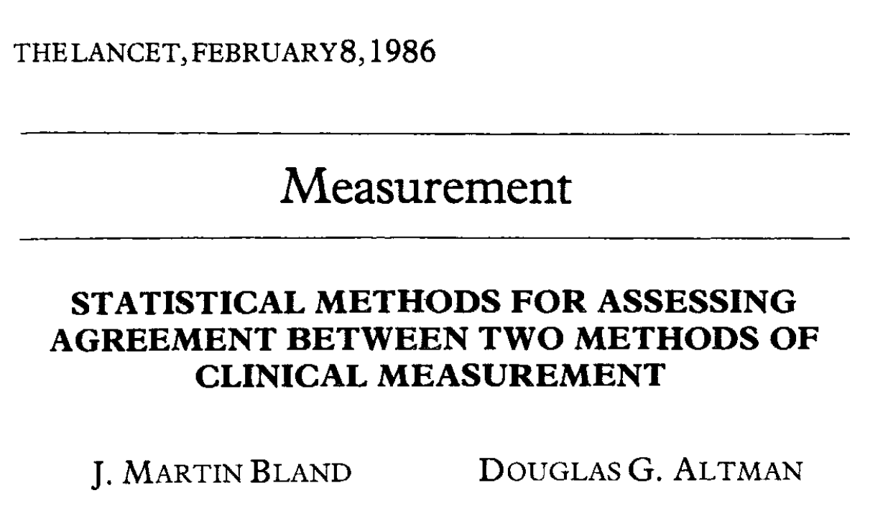
Bland-Altman plot example
Wanting to determine how much a new measurement instrument agreed with an existing measurement instrument, correlation was traditionally used but was incorrect because –
We would expect correlation
Instruments could correlate but not agree
Agreement could differ at different measurement levels

Slide 2
Can we adapt these plots for ancestral inference benchmarking?
Check how consistent predictions are across multiple tools
GRASP vs FastML vs PAML
We don’t know the ‘true’ ancestral state – so use predicted molecular weight as the measurement
Also use five Atchley indexes (Atchley, 2005) that summarise –
Molecular size, amino acid composition, electrostatic charge, polarity, and secondary structure
For ever pair of internal nodes in between two ancestral predictions – plot evolutionary age against differences between ancestors

Slide 3
Associate nodes between pairs of methods
GRASP FastML PAML
Associate nodes between pairs of methods
Transform sequence at each node into metric (mol. Weight / Atchley index)
Work out the differences between each score
Note: PAML doesn’t predict gaps -
Grasp root node
FastML root node
PAML root node

Slide 4
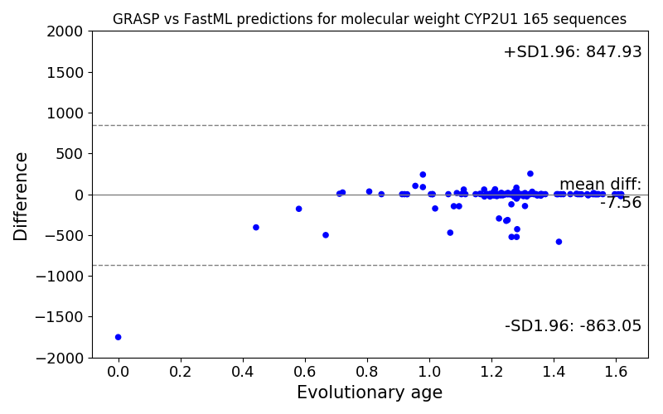
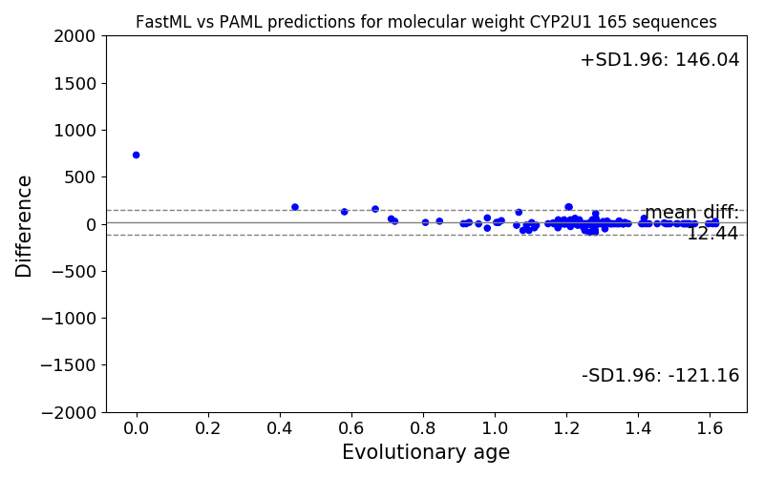
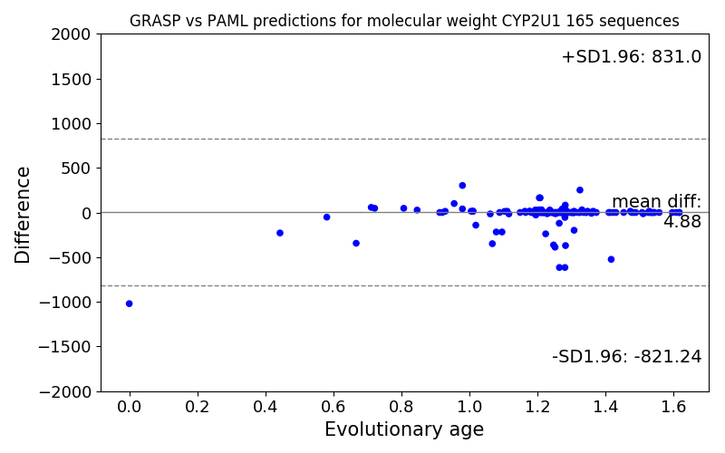

Slide 5
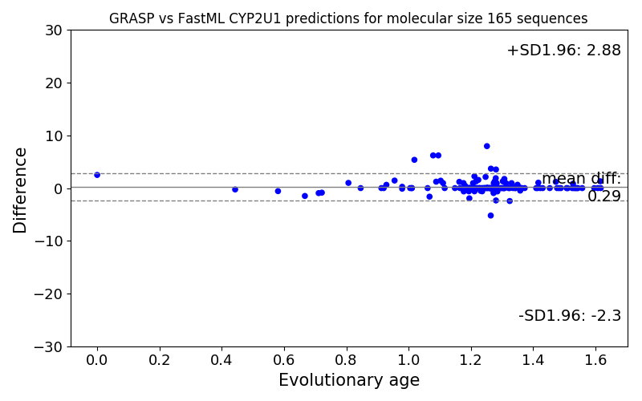
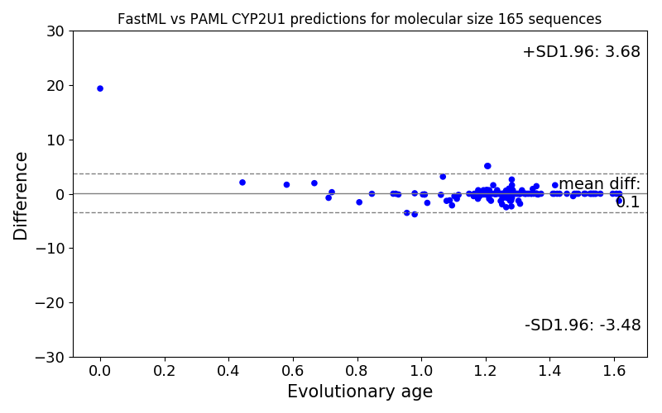
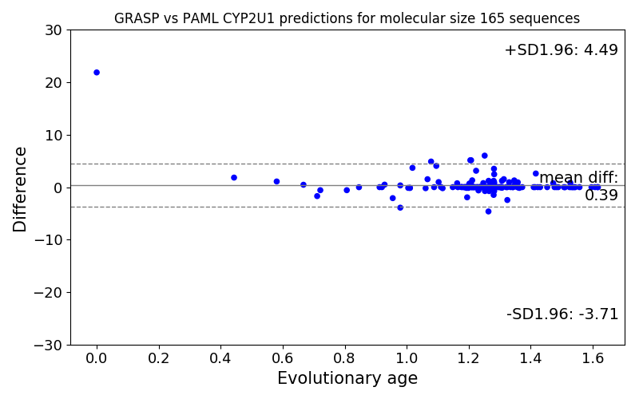

Slide 6
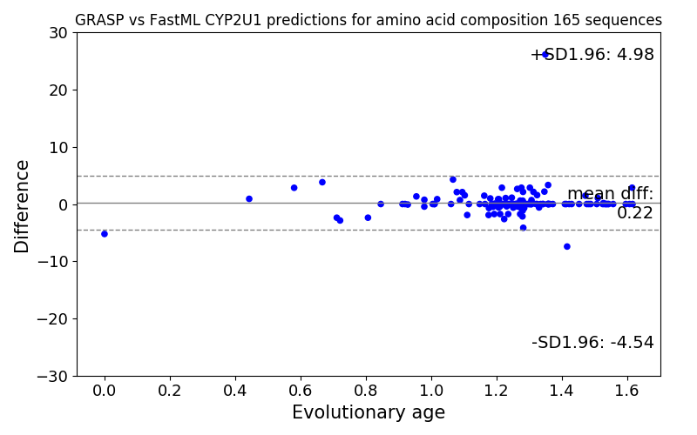
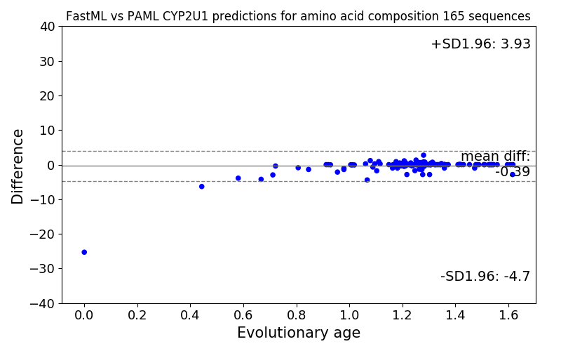
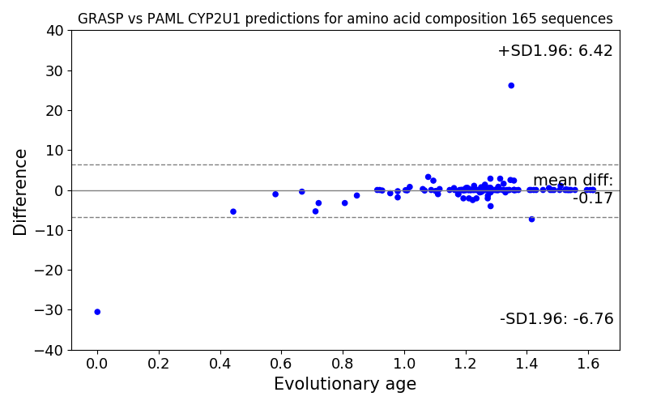

Slide 7
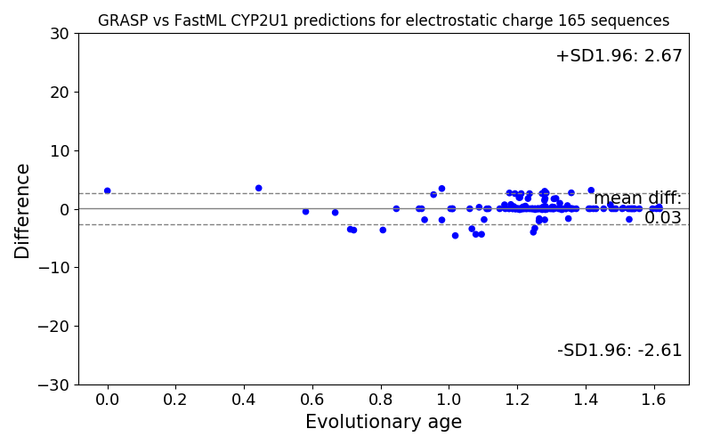
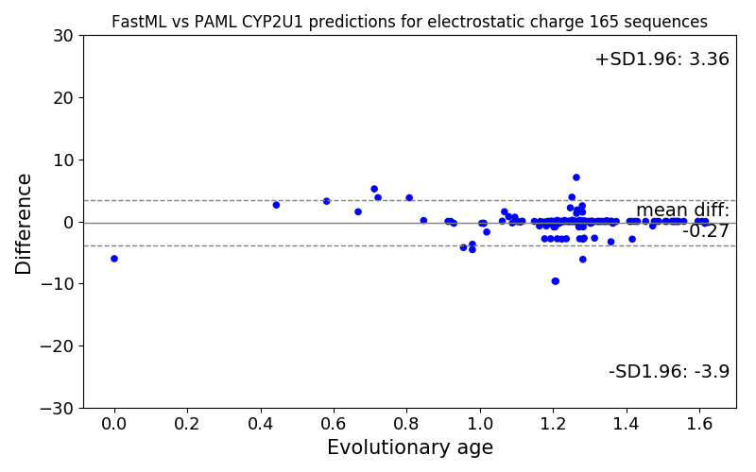
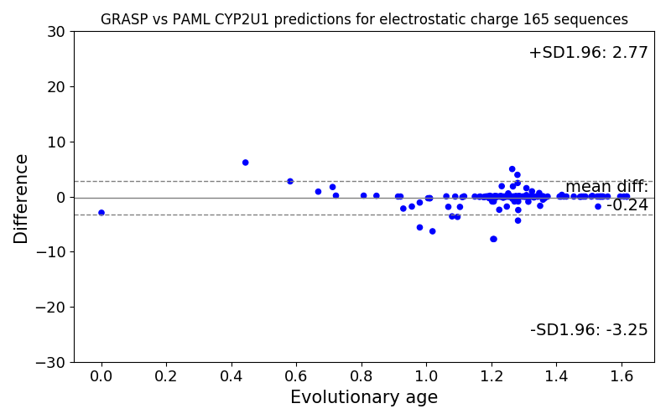

Slide 8
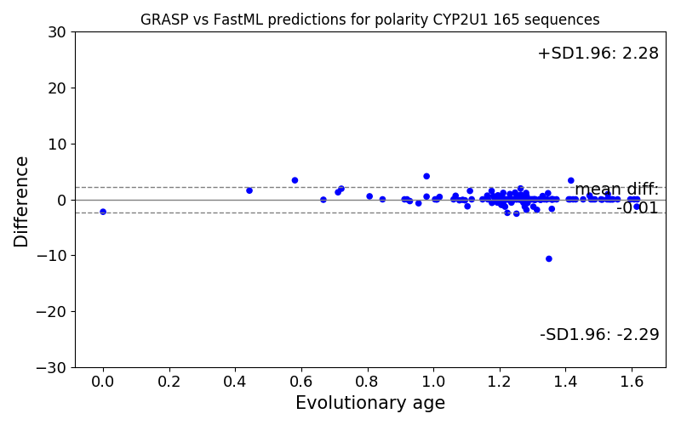
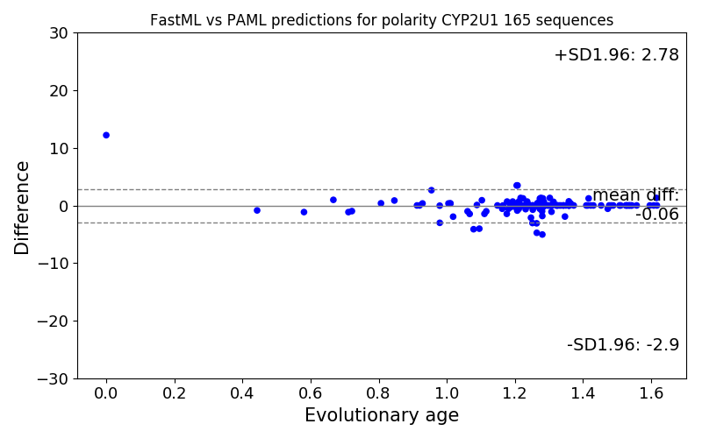
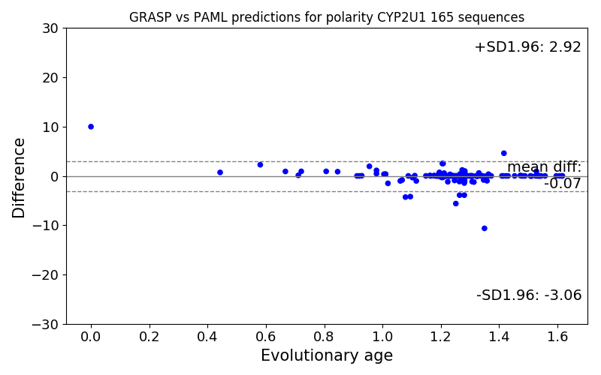

Slide 9
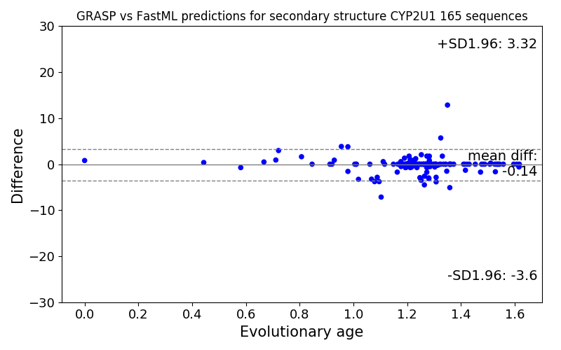
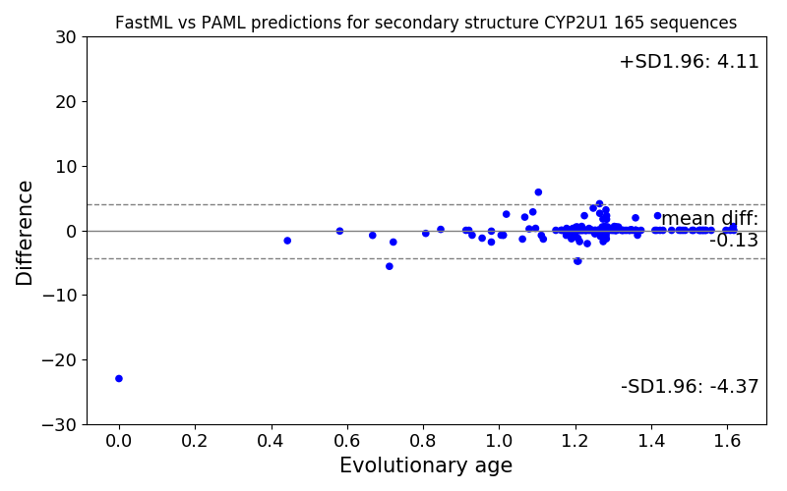
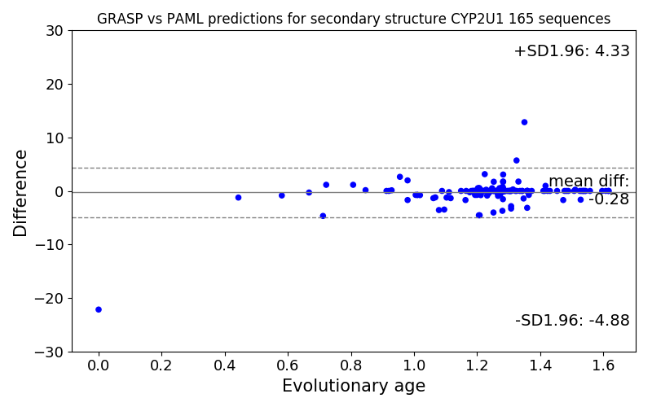

Slide 10
Next steps
Repeat analysis on CYP2U1 / CYP2R (359 sequences) and CYP2U1 / CYP2R / CYP2D (595 sequences)
Repeat analysis on other ancestors predicted for the GRASP paper (mostly based on different tree topologies)
Repeat analysis on trees that are subsets of other trees.

Slide 12
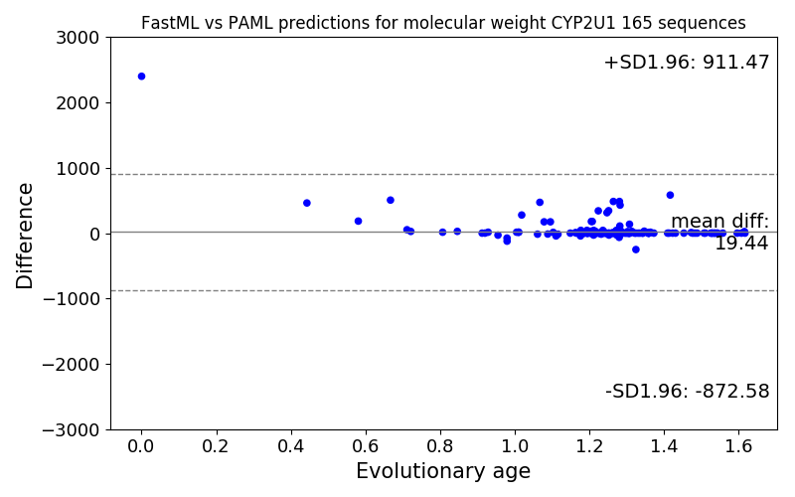
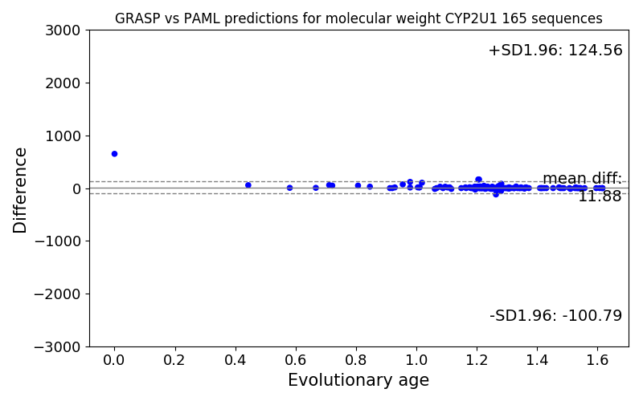
PAML with GRASP-like gap patterns

Slide 14
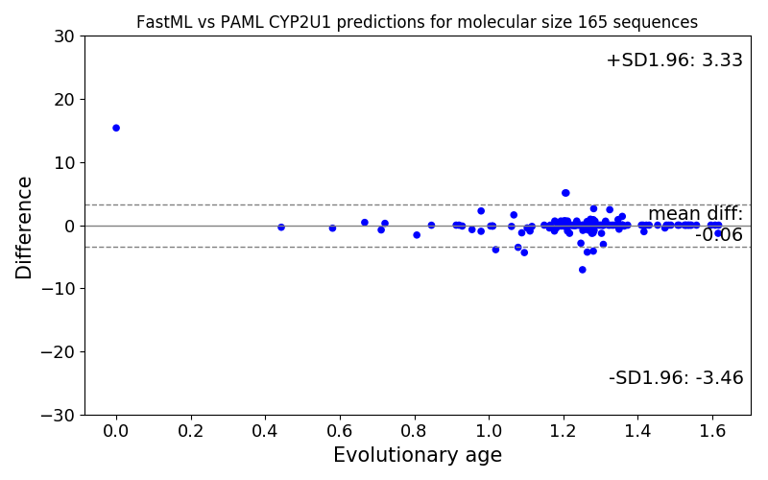
PAML with GRASP-like gap patterns

