Slide 1
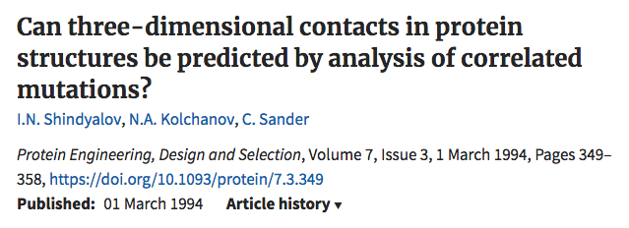
Shindyalov et al. (1994) details an approach to identify correlated mutations along specific branches of a phylogenetic tree. Uses phylogeny and ancestral inference.
Tuff & Darlu (2000) implement and test Shindyalov’s method as well as their own simulation-based approach.

Slide 2
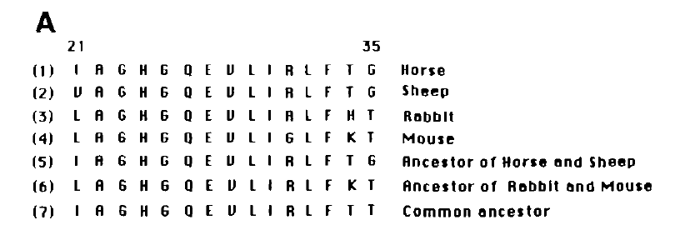
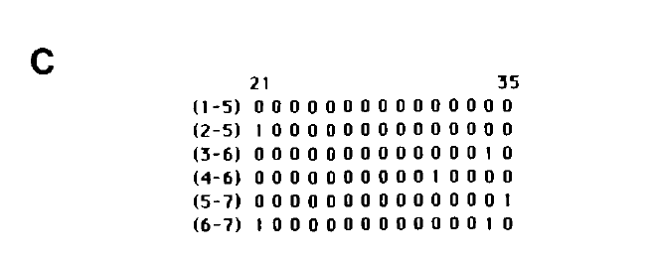
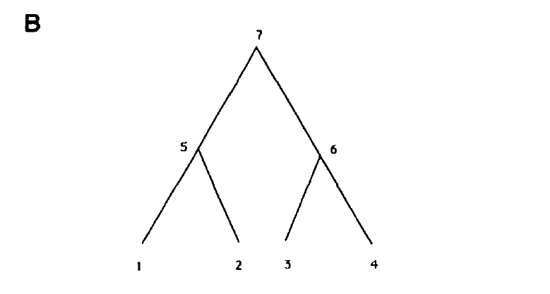
Looking at mutational changes along branches.
The matrix in C) will only record when there is a change between parent and child – and then the interest is when multiple events occur on a single branch – only along (6-7) in this example.

Slide 3
$$L=sequence length$$
$$K=number of branches$$
$$l=position in sequence$$
$$k=branch index$$
$g_{lk}$ = $\left\{\begin{aligned}1, if mutation occured on branch k at position l \\ 0, otherwise\end{aligned}\right.$
Consider two positions $l_{1}$and $l_{2}$to be correlated if they occur on the same $k$th branch, i.e. -
If the probability to obtain by chance $M_{l_{1}l_{2}}$ or more correlated mutations at positions $l_{1}$ or $l_{2}$ is small, then we can consider these as correlated positions.
$g_{l_{1}k}∙g_{l_{2}k}$ = 1
Total number of correlated mutations for a pair of positions is just a sum over all branches -
$$M_{l_{1}l_{2}}= \sum_{k=1}^{K}{g_{l_{1}k}∙g_{l_{2}k}}$$

Slide 4
$$G_{k}= \sum_{l=1}^{L}{{g_{lk}}/N}$$
Average frequency of mutations on $k$th branch, averaged over all$L$ positions
$$G_{l}= \sum_{k=1}^{K}{{g_{lk}}/N}$$
Average frequency of a mutation in the $l$th position, averaged over all $K$branches
Estimated probability of observing a mutation at the $l$th position on the $k$th branch of a tree with a total of $N$ mutations. Term in brackets is the probability of seeing no mutation in a single attempt.
$$P_{lk}=1 −(1 − G_{k} ∙ G_{l})^{N}$$
$$P\left(M_{l_{1}l_{2}}\right)=1 −\sum_{j=0}^{M_{l_{1}l_{2}}−1}{\sum_{i=0}^{C_{K}^{j}}{\prod_{k=1}^{K}{D_{l_{1}l_{2}}k}}}$$
Probability of obtaining by chance $M_{l_{1}l_{2}}$or more correlated mutations in positions $l_{1}$ and $l_{2}$
(1) (2) (3)
(1) The different total numbers of correlated branches in positions $l_{1}$ and $l_{2}$
(2) Different ways to place $j$ correlated mutations in $K$branches
(3) Probability for a particular mutation state in branch $k$ in positions $l_{1}$ and $l_{2}$
$$D_{l_{1}l_{2}}k\left\{\begin{aligned}P_{l_{1}k} ∙P_{l_{2}k}, if kth branch contains correlated \\ mutations in positions l_{1} and l_{2} \\ \\ \\ 1 −P_{l_{1}k} ∙P_{l_{2}k}, otherwise\end{aligned}\right.$$

Slide 5
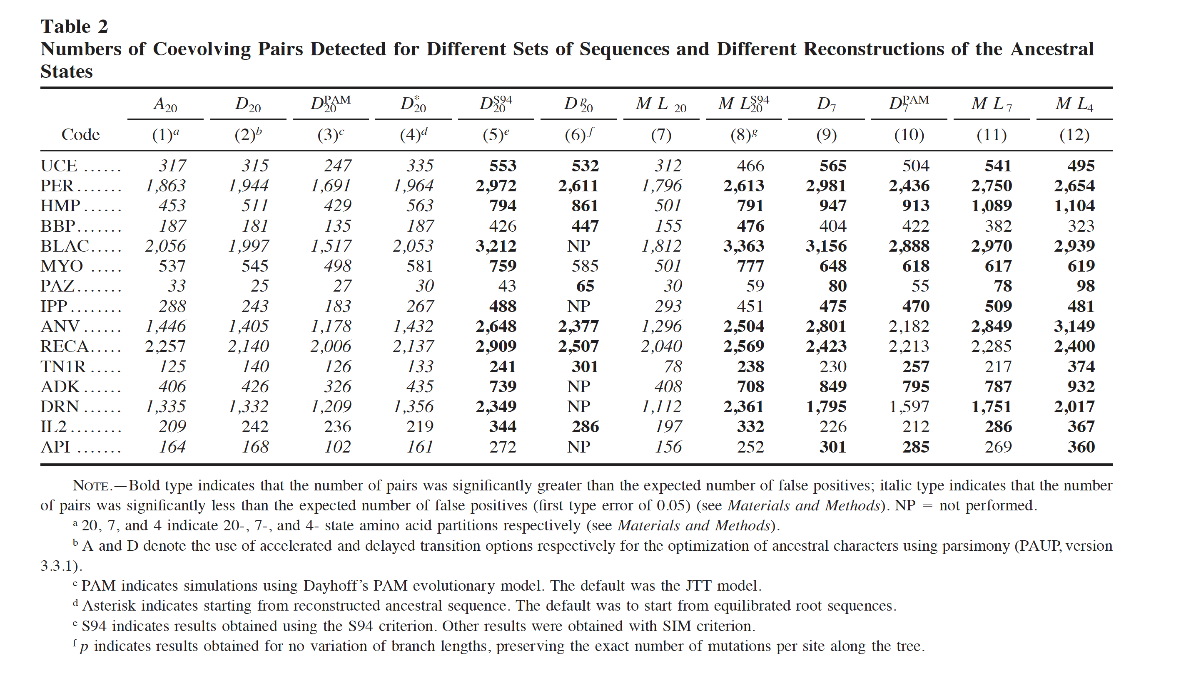

Slide 6
General thoughts
Phylogenetic signal can either be used to - identify specific branches rather than columns - remove the influence of correlations due just to shared ancestry Detecting coevolution without phylogenetic trees? Tree-ignorant metrics of coevolution perform as well as tree-aware metrics (2008) - Looks at whether we can control shared ancestry through means other than phylogeny. I.e. it isn’t assessing if there are other gains from using phylogeny. In our case I think we can identify branches of interest first, and then identify co evolving positions on these branches.
Do we want to use a reduced-state alphabet

