Slide 1
Partial order alignment
Graphical model representing a multiple sequence alignment
Model gaps by alternative pathways through the graph

Slide 2
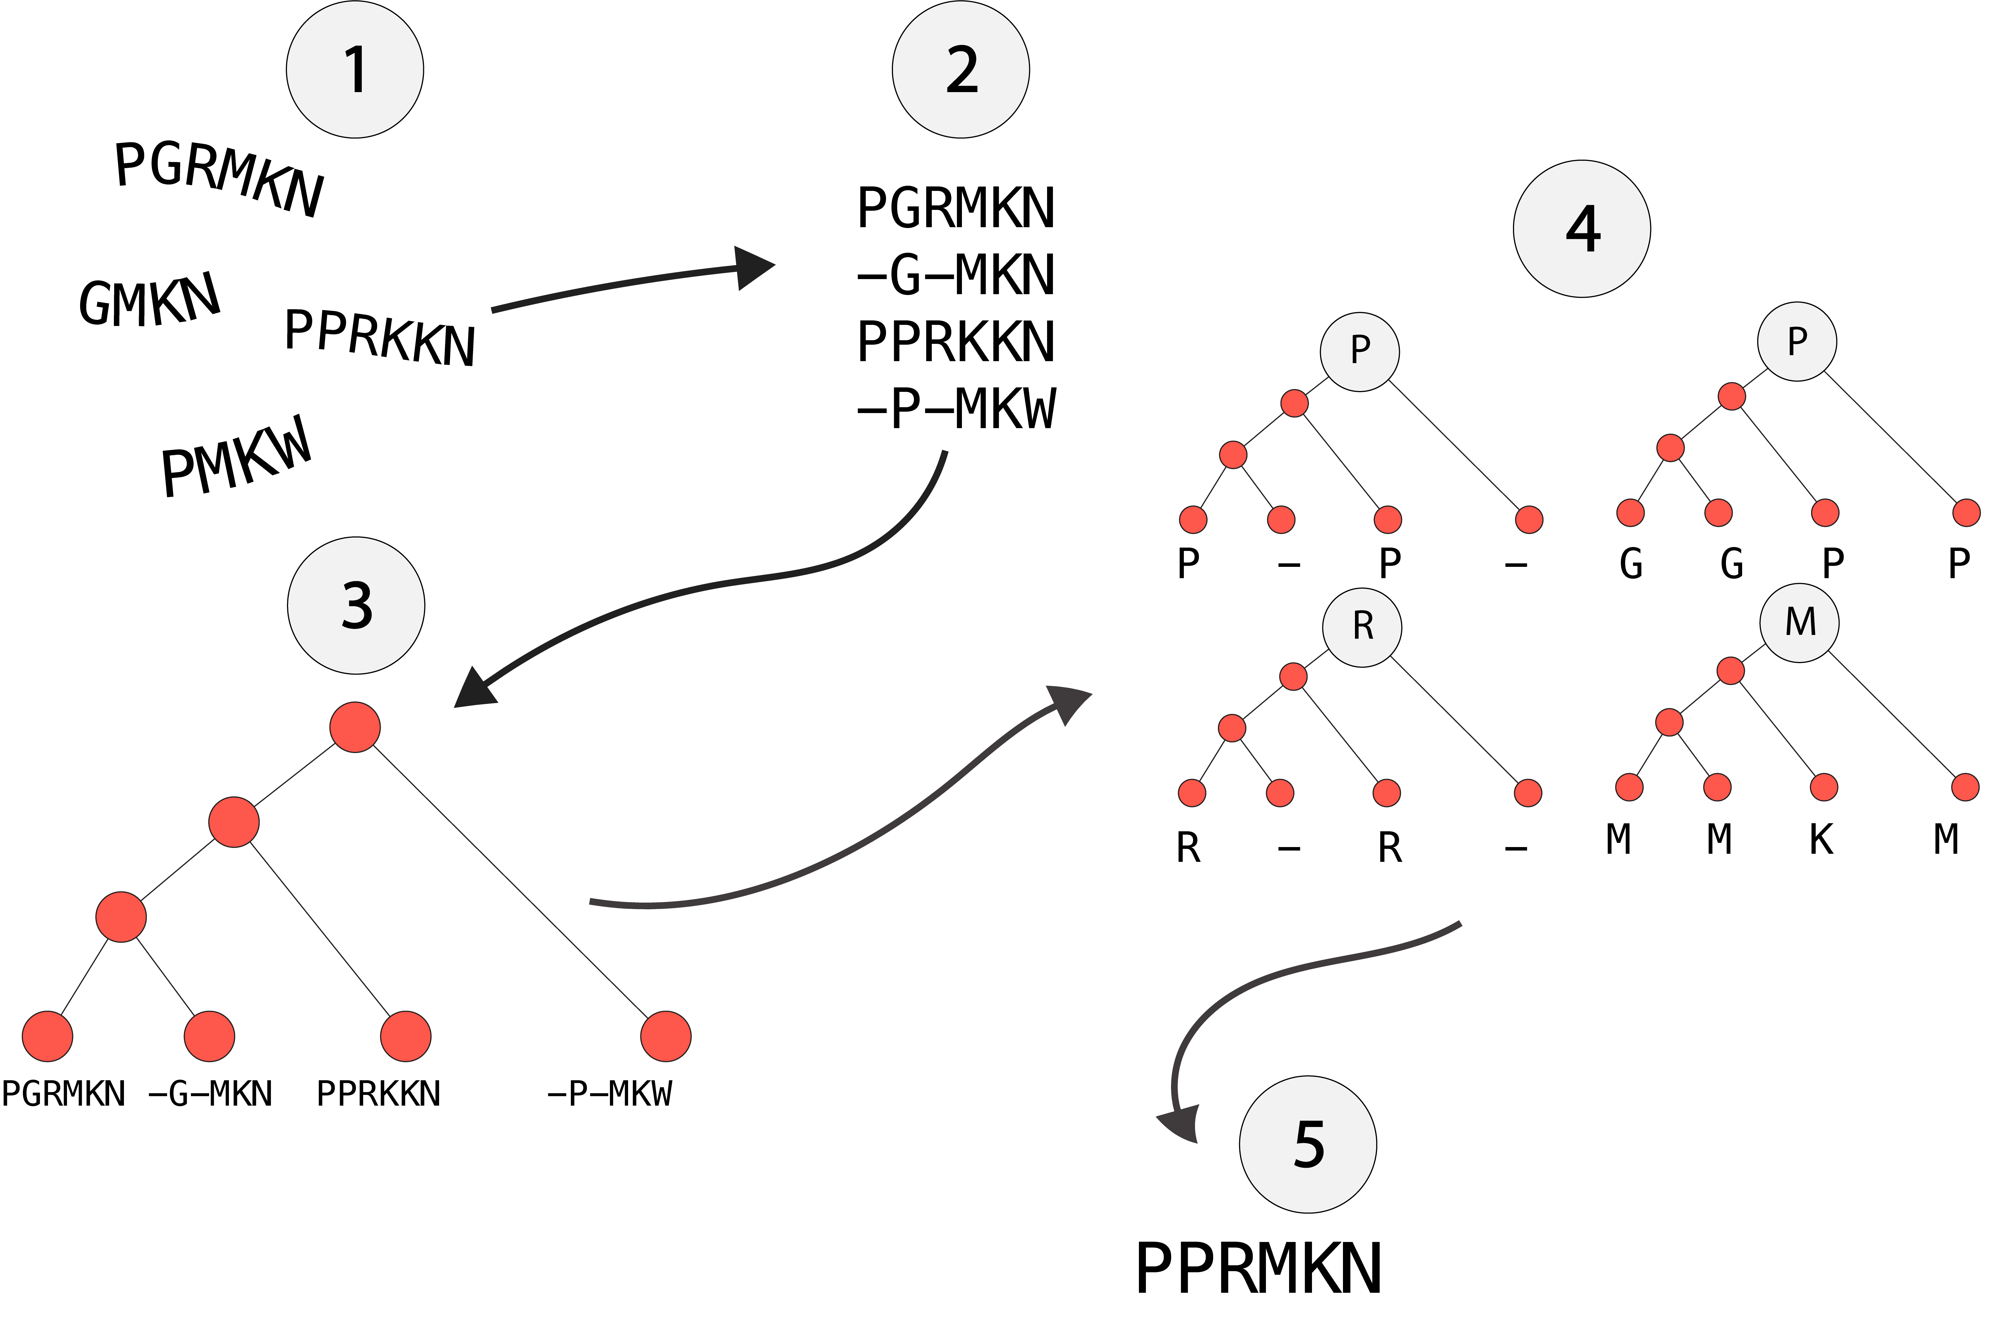
Ancestral sequence reconstruction
Collect sequences
Align sequences
Inger phylogenetic tree
Calculate the most probable set of ancestral characters
Join together all of the inferred characters from each position

Slide 3
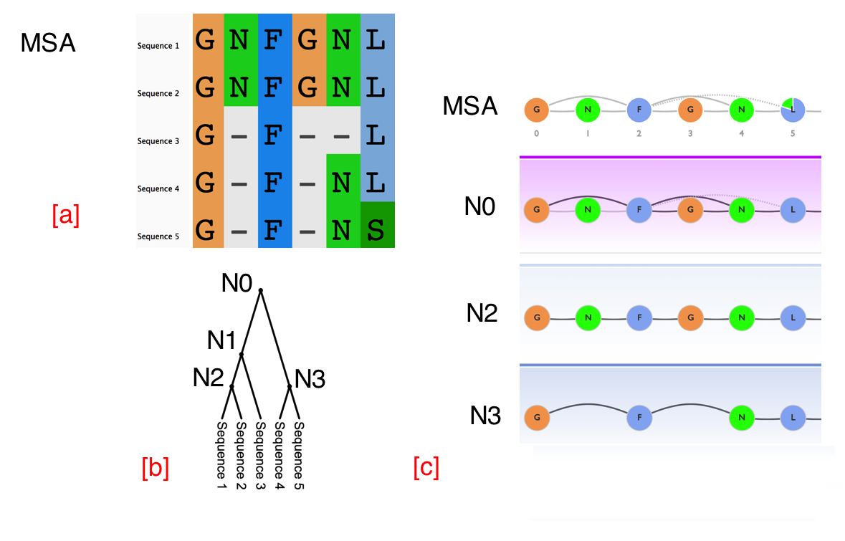
Graphical Representation of Ancestral Sequence Predictions (GRASP)
Note the asparagine in the second position is inferred as present in the ancestral N2 node and absent in the ancestral N3 node.
In the oldest ancestor (node N0) the asparagine is inferred as a deletion since the path with the greatest support (darker edge) skips the asparagine.

Slide 4
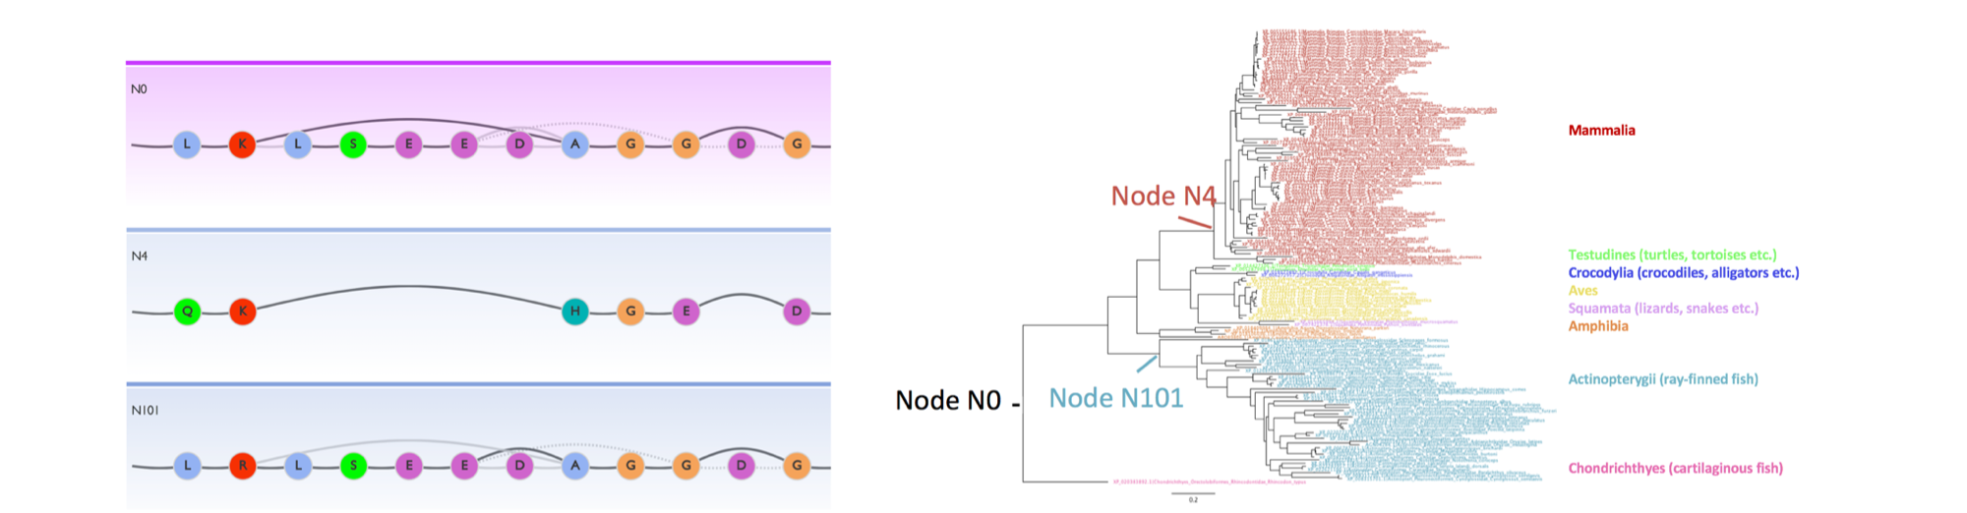
GRASP applied to cytochrome P450 2U1 subfamily
Nodes that highlight insertion / deletion events that occurred throughout the CYP2U1 subfamily evolution

