Slide 1
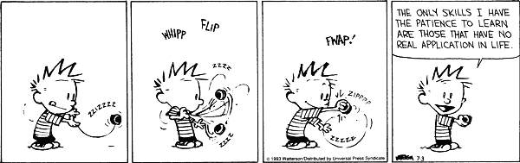
Partial order graphs
Overview and biological relevance

Slide 2
Overview
Partial order graphs
Partial order alignment
Biological relevance
Branch isolation

Slide 3
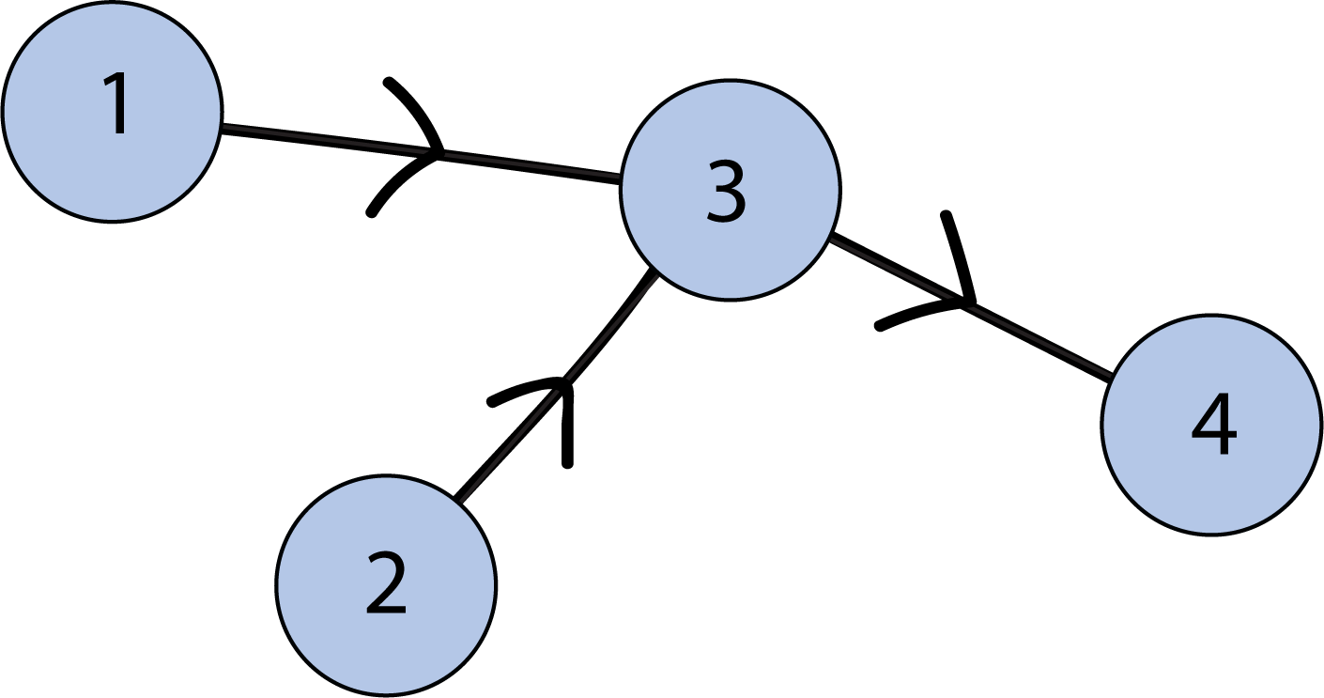

Partial order graphs
1 < 3
2 < 3
3 < 4
Reflexivity: $x≤x$for all $x ∈S$
Anti-symmetry: $x≤y$ and $y≤x$ if and only if $x=y$
Transitivity: if $x≤y$ and $y≤z$ then $x≤z$
Useful for representing:
Ambiguity
Variability

Slide 4
Partial order alignment
Represent ambiguity
Doesn’t result in incorrect gap penalisation

Slide 5
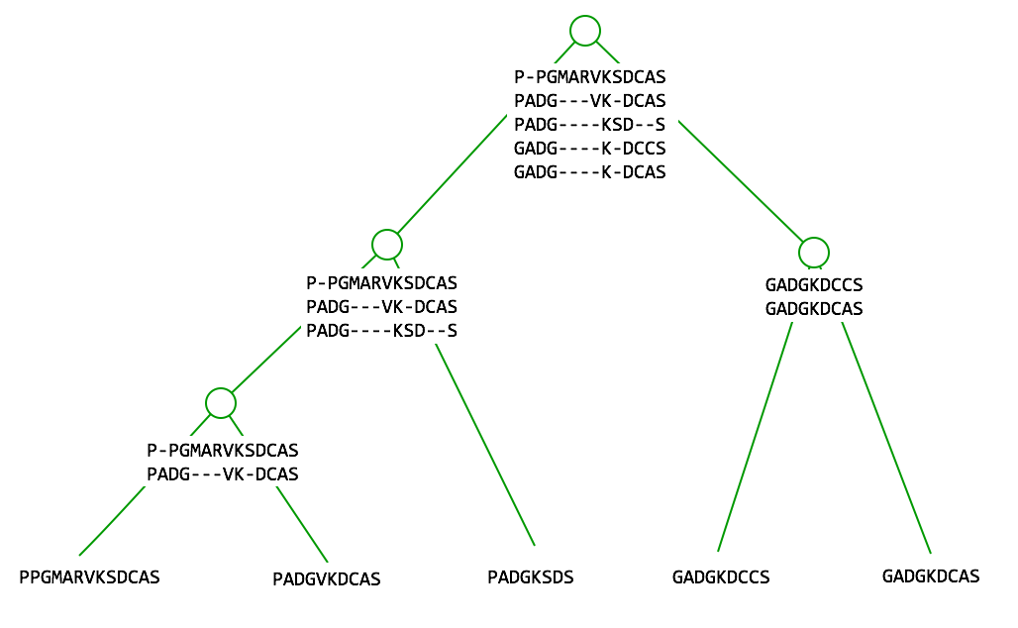
Progressive alignment
Problem: “Once a gap, always a gap”
(Feng & Doolittle, 1987)
Problem: Incorrect handling of insertions

Slide 6
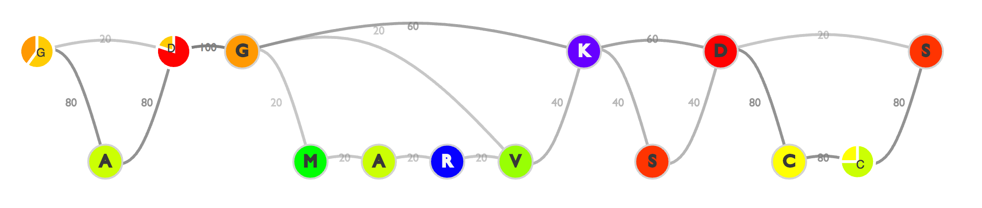
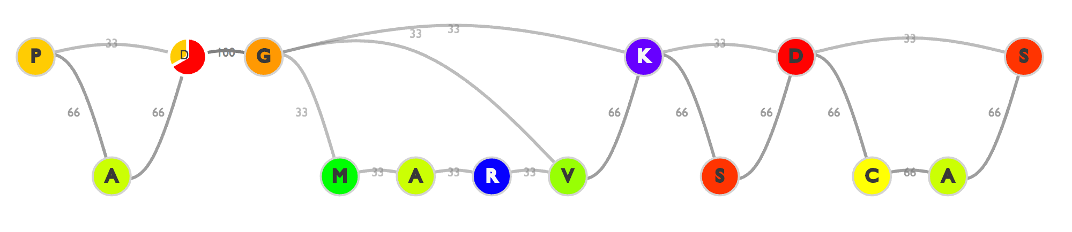
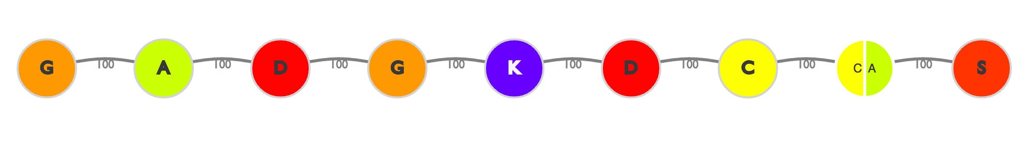
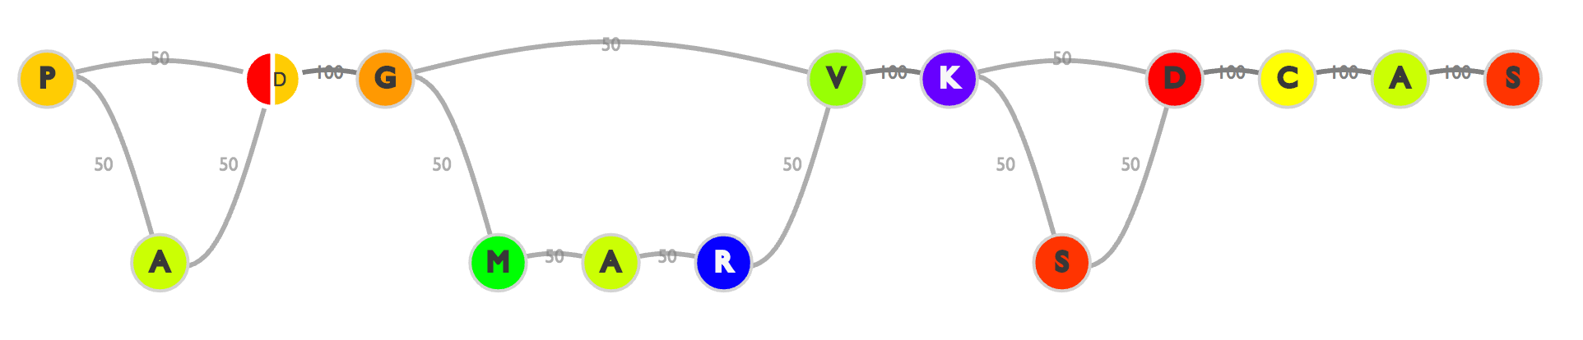
Progressive partial order alignment

Slide 7
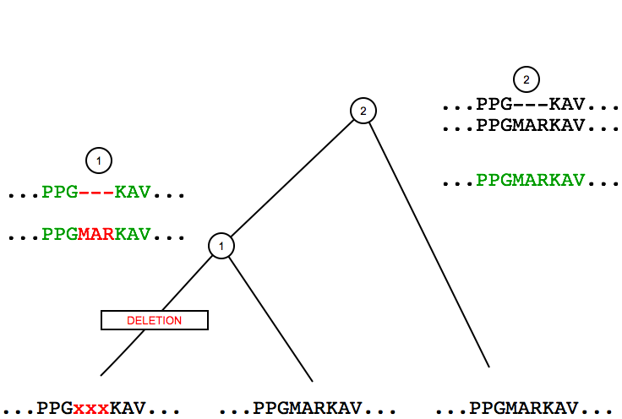
Deletion in progressive MSA
Modelled correctly
Doesn’t result in incorrect gap penalisation

Slide 8
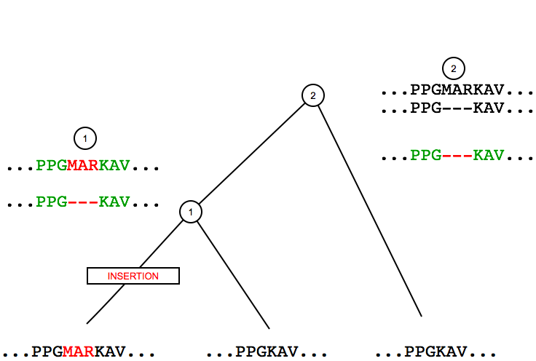
Insertion in progressive MSA
Modelled incorrectly
Results in incorrect gap penalisation

Slide 9
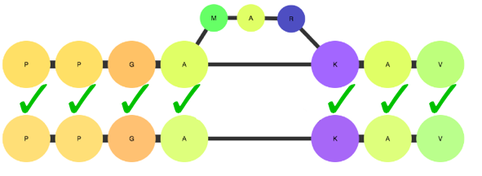
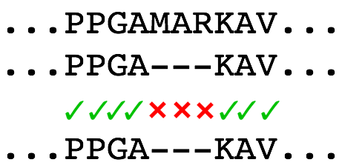
Gap penalties with partial order graphs

Slide 10
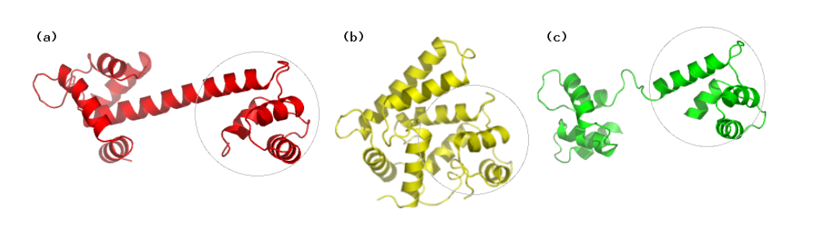
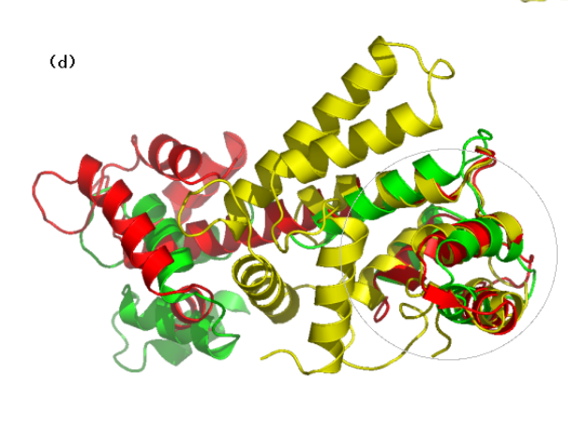
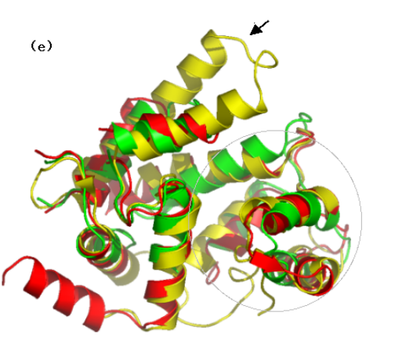

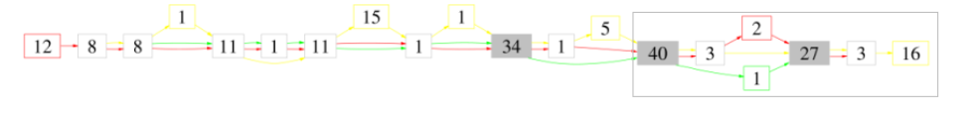
Biological relevance – structural alignment
(Ye & Godzik, 2005)
(a), (b), and (c) show Calmodulin structures
(d) shows a rigid alignment
(e) shows a flexible partial order alignment
(f) shows the underlying partial order alignment of (e)

Slide 11

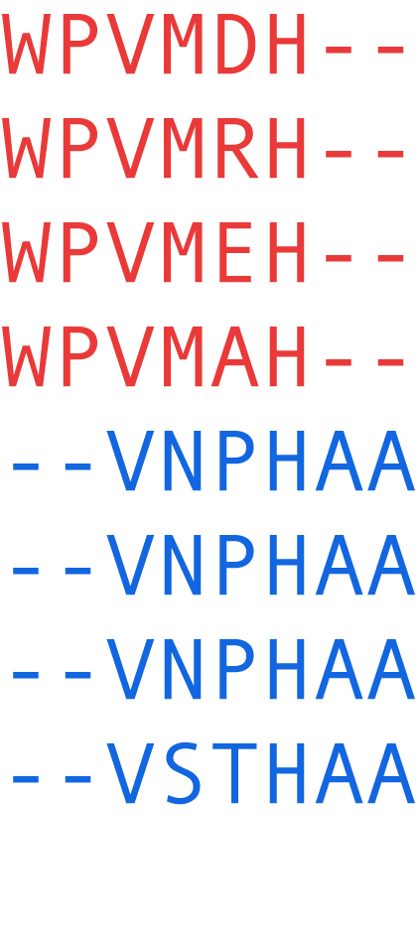
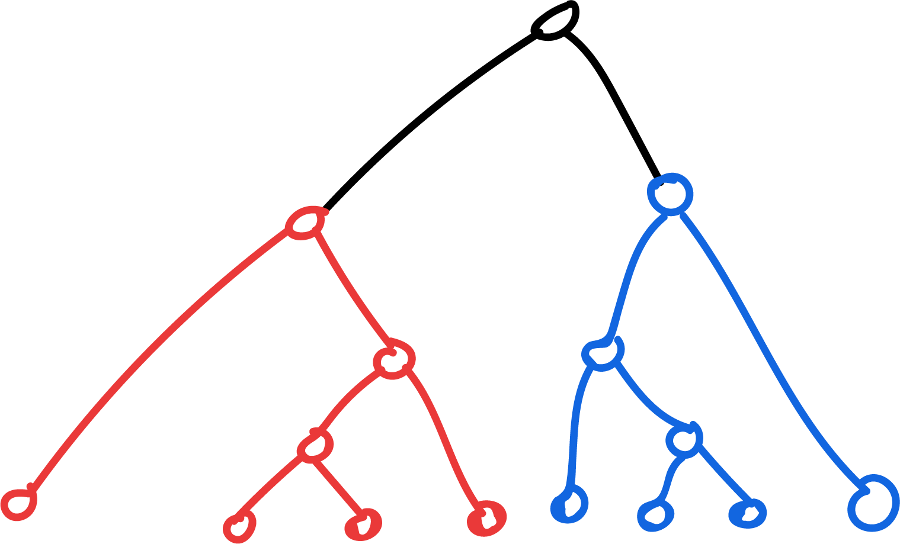
Branch isolation
KESTREL. FALCON HAWK EAGLE PONY DONKEY HORSE ZEBRA

Slide 12
Branch isolation discovery
Look at cases when marginal reconstruction is being influenced by a particular branch
Take a node of interest –
  Check to see if there are nodes in the child where the distribution of the marginal reconstruction and the distribution of alignment disagree
  Check to see if the parent node and other child agree
  Check to see if this pattern occurs in each child node in an overlapping way
Two ways – graph based (look at indels) and tree based (look at pathways)

Slide 13
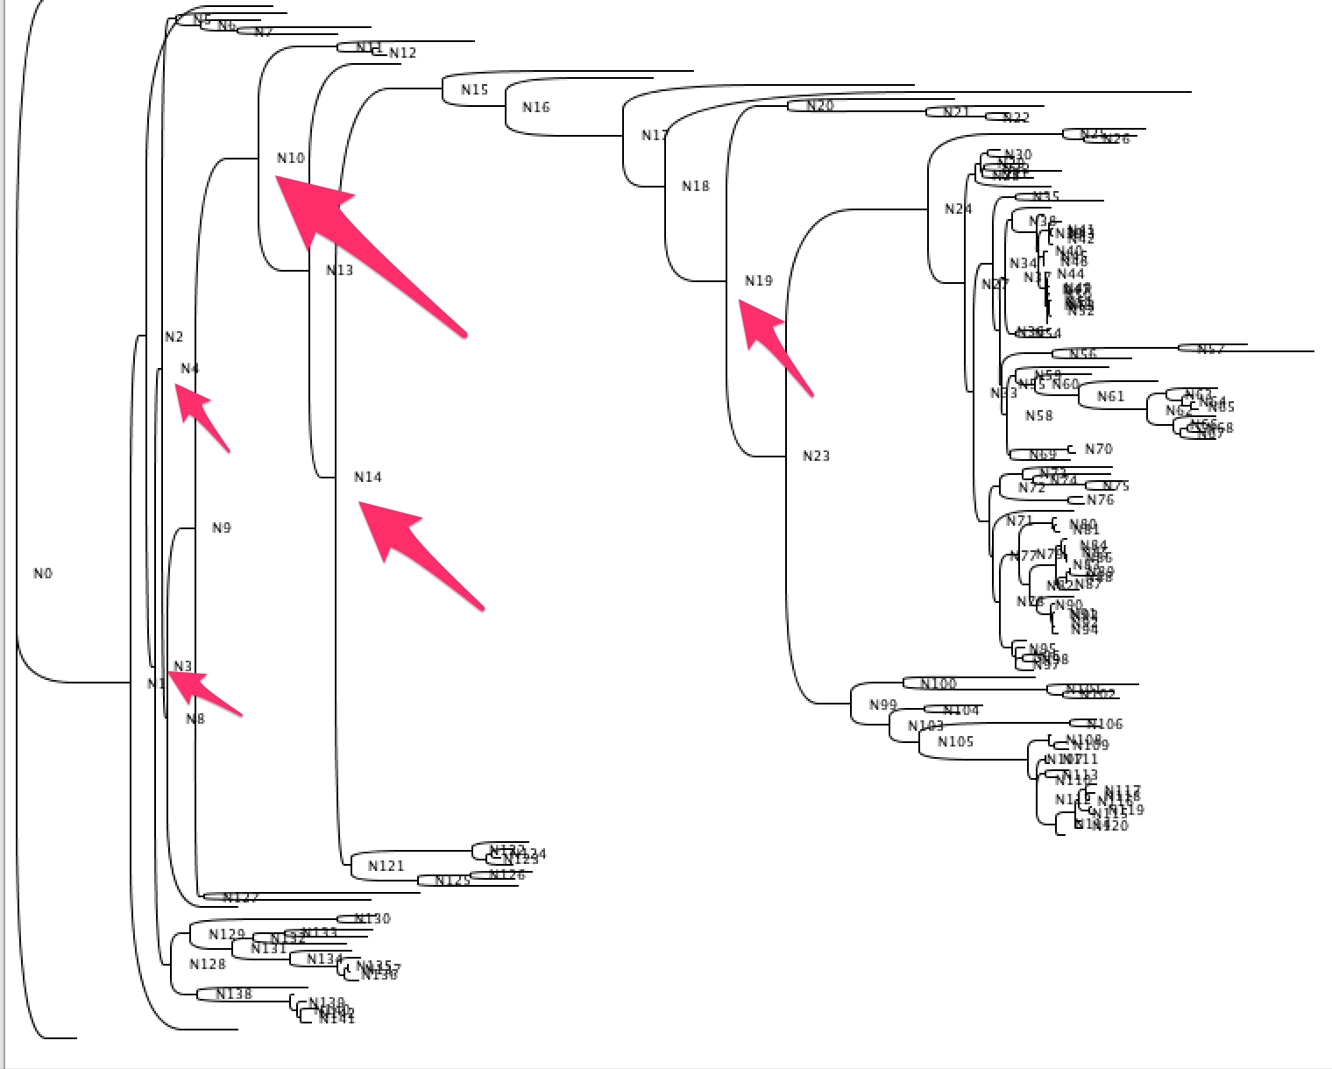
Branch isolation results
Enforcing the constraint of other child agreeing with alignment
N3
113, 123, 129, 187,306,
N4
185, 382, 591
N10
86,92,96,112,122,192,193,203,209,227,238,265,311,361,373,393,448,458,558,596
N14
120,140,146,235,258,284,305,306,319,323,325,343,448,449,486,490,546,559
N19 124,130,147,158,163,175,188,200,225,303,360,386,397,452,457,467,468,471,479,519,562,563,567,575,600,612,628

Slide 14
References
Feng, D.-F., and Doolittle, R.F. (1987). Progressive sequence alignment as a prerequisite to correct phylogenetic trees. Journal of Molecular Evolution 25, 351–360.
Ye, Y. & Godzik, A. Multiple flexible structure alignment using partial order graphs. Bioinformatics 21, 2362–2369 (2005).

Slide 15
Branch isolation results
Not enforcing the constraint of other child agreeing with alignment
Enforcing the constraint of other child agreeing with alignment
N3
113, 123, 129, 187, 192, 306, 462, 625
N4
185, 239, 382, 542, 591
N10
86,89,92,96,111,112,122,181,192,193,203,209,227,237,238,265,296,306,311,337,358,361,373,393,448,457,458,462,468,546,558,596,633
N14
80,93,120,140,146,151,153,164,166,178,188,223,235,241,258,269,284,292,296,302,304,305,306,319,323,325,343,386,409,448,449,486,490,546,559,564,626,627,629
N19
2,72,73,74,75,120,121,124,125,130,147,158,163,165,175,178,179,188,200,225,303,311,332,354,360,378,386,397,411,415,452,457,467,468,471,479,519,553,562,563,567,575,594,600,607,612,628,630
N3
113, 123, 129, 187,306,
N4
185, 382, 591
N10
86,92,96,112,122,192,193,203,209,227,238,265,311,361,373,393,448,458,558,596
N14
120,140,146,235,258,284,305,306,319,323,325,343,448,449,486,490,546,559
N19
124,130,147,158,163,175,188,200,225,303,360,386,397,452,457,467,468,471,479,519,562,563,567,575,600,612,628

