Slide 1
A Bayesian network approach
Alex Essebier

Slide 2
Transcription factors (TFs)
Proteins that can bind specific DNA sequences
Regulate transcription
From hundreds to tens of thousands of binding sites
Binding locations vary:
Across cell types
Between different TFs
Binding depends on
DNA sequence
Chromatin accessibility
Other TFs
Notes:
Number of sites: 100’s to 10’s of thousands

Slide 3
Chromatin immunoprecipitation followed by sequencing: ChIP-seq
To determine protein binding sites in the genome
Cannot assay every TF-cell type-condition combination
Some TFs cannot be assayed by ChIP-seq
How do you explore a TF when you can’t experimentally detect binding?

Slide 4
The Challenge
Develop and apply computational methods that can integrate multiple datasets to predict
in vivo binding maps of a diverse collection of
TFs in a variety of cell lines
Given a TF, a location and a cell type, what is the probability of binding?

Slide 5
Training data
Transcription factor binding data (ChIP-seq)
TF and cell type specific
32 TFs across 14 cell types → 123 combinations
200bp window with 50bp slide
Each window labelled
‘U’ – unbound – no evidence of binding
‘A’ – ambiguous – low confidence binding site
‘B’ – bound – high confidence binding site

Slide 6
Training data
51,676,737 windows across the Human genome

Slide 7
Training data
The Human reference genome (hg19)
Motif scanning
Locations of genes
Chromatin accessibility data
DNase-I hypersensitivity (DHS)
DHS footprints for 512 JASPAR motifs
Gene expression data
RNA-seq
✓
✓
✓
✓
✗

Slide 8
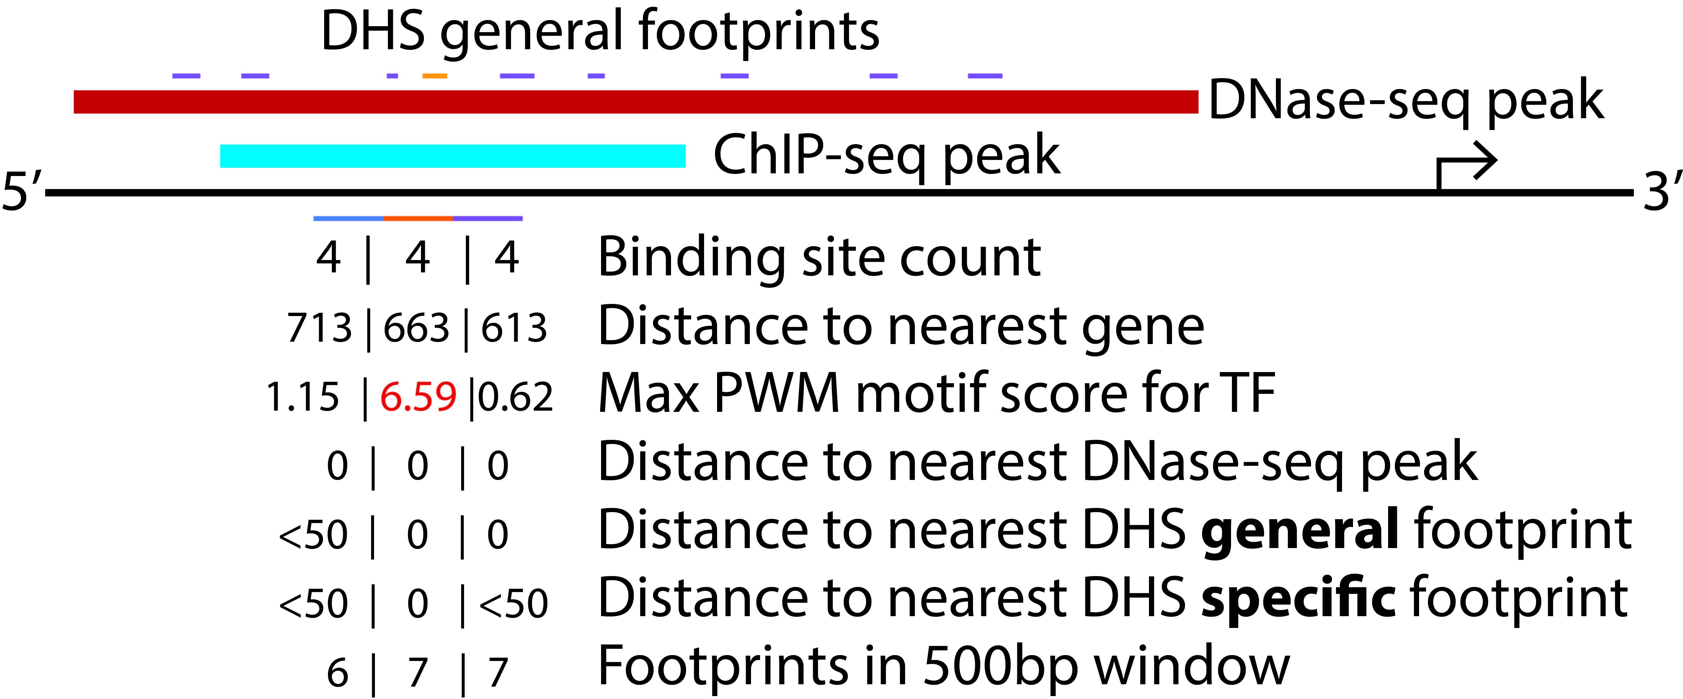
Training data

Slide 9
Bayesian network
Probabilistic model
Captures patterns and relationships in data
Trained using Expectation Maximisation
An iterative method to find model parameters that best fit the data

Slide 10
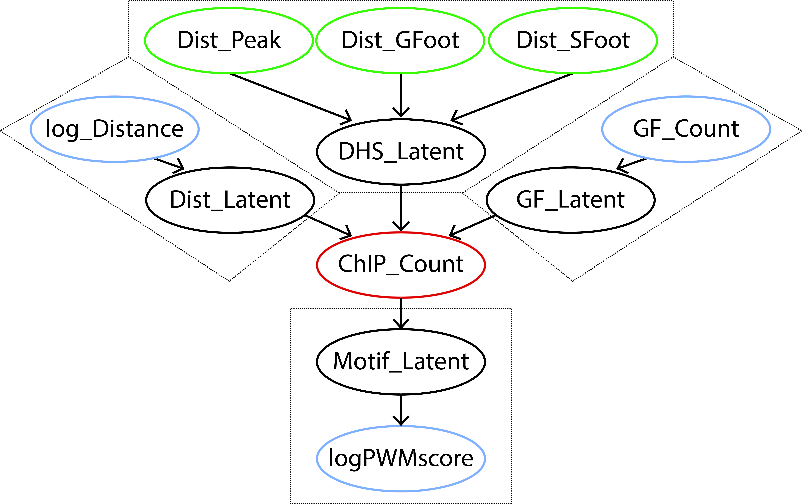
Model

Slide 11
Handling big data
Exclude sites which did not overlap a DHS peak or ChIP-seq peak
10,154,598 sites of length 50bps
Ensemble model:
≥ 10 models for each TF
≥ 2 models per training cell type
K562
MCF-7
A549
GM12878

Slide 12
Results
Tested the trained models on 8,843,011 locations
On cell types unobserved in training

Slide 13
Moving Forward
Next deadline: 11th January 2017
Plans:
Improve model
Optimise parameters
Explore what led to changes in performance
Improve Ensemble approach
Implement a better solution than averaging ensemble predictions

Slide 14
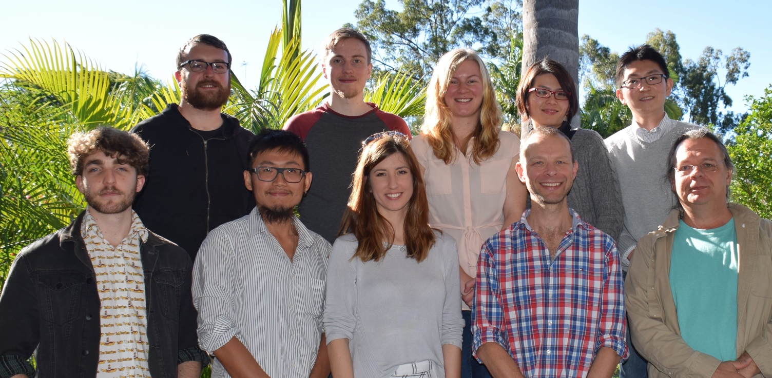
Thanks
Supervisor: Mikael Bodén
Bodén group

